Slide 1
MULTI-CUT REBAR(9)
Advisor : Prof. K.C.Chang
Presenters : You-Ran Nai

Slide 2
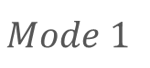
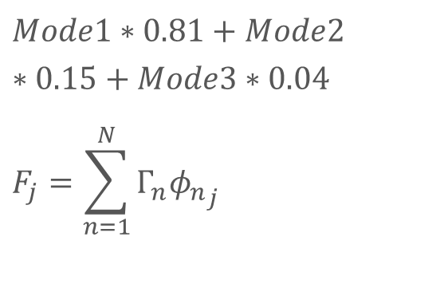
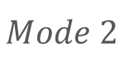
Mode Pushover
0.525
-0.319
0.427
$$Mode1∗0.81+Mode2∗0.15+Mode3∗0.04$$
$$F_{j}=\sum_{n=1}^{N}{Γ_{n}{φ_{n}}_{j}}$$
0.343
0.321
0.402
0.132
0.359
0.171
$$Mode 1$$
$$Mode 2$$
MMC
Notes:
Pushover mode 1, 2, MMC
柱產生塑角

Slide 3
Const
e2k
Excel

Slide 4


Slide 5
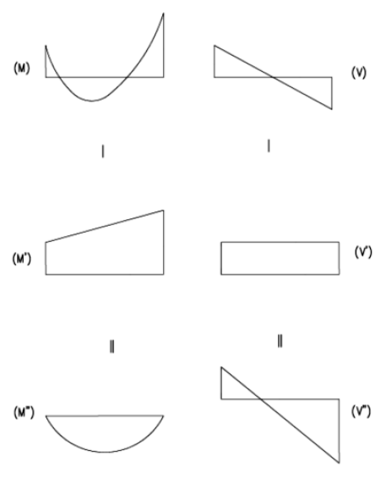
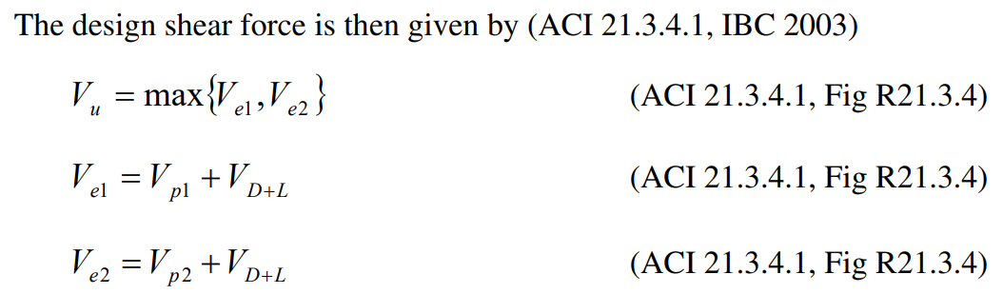
Sway Special

Slide 6
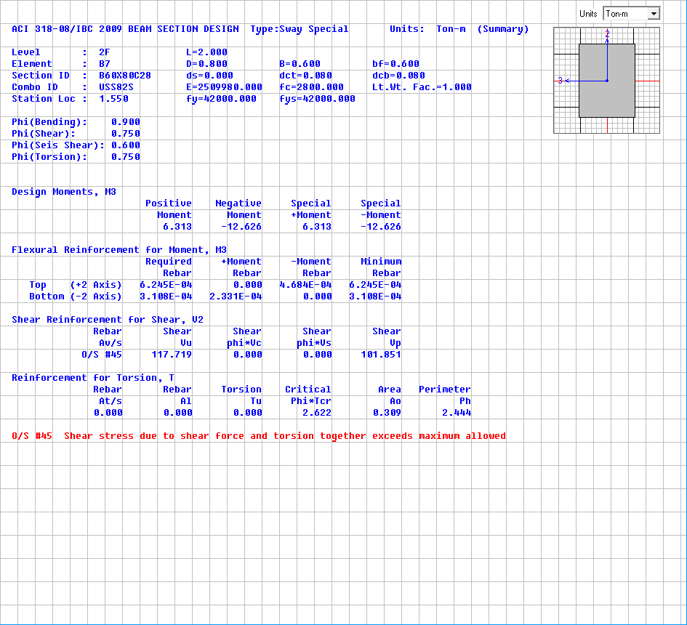
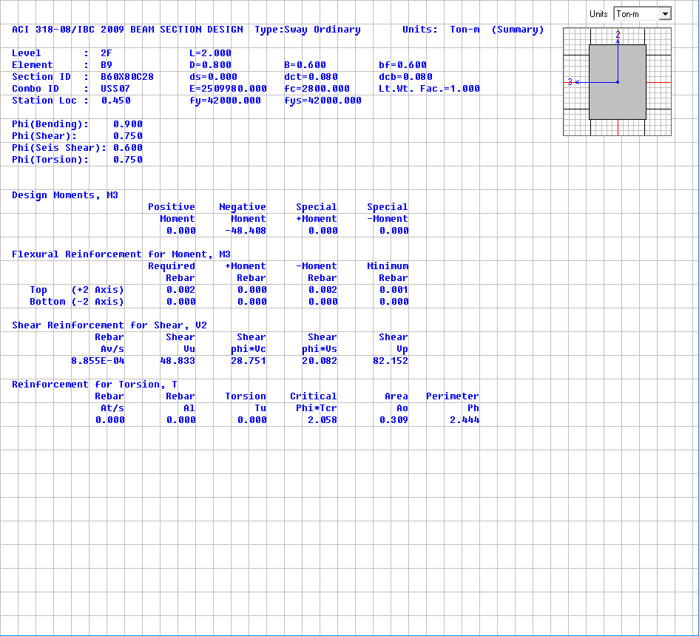
Shear Design
Sway Special(Consider Vp)
Sway Ordinary(No Consider Vp)
Vp=101.851t
Vu=117.719t
Vp=82.152t
Vu=48.833t

Slide 7
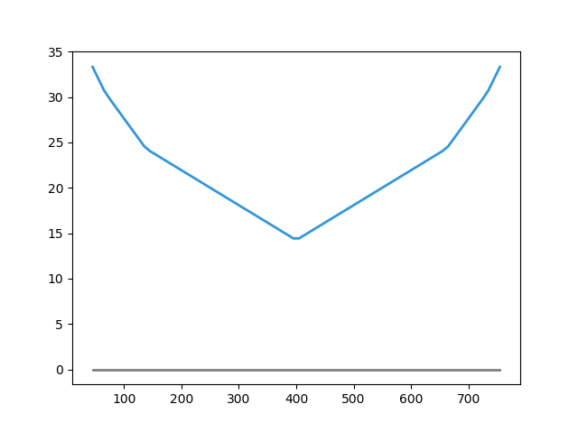
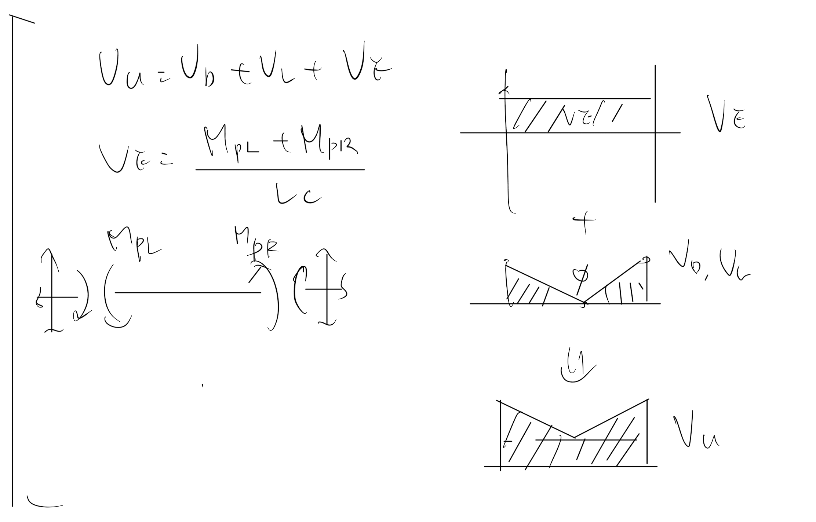
Shear Design
Easbs Shear Rebar Area

Slide 8
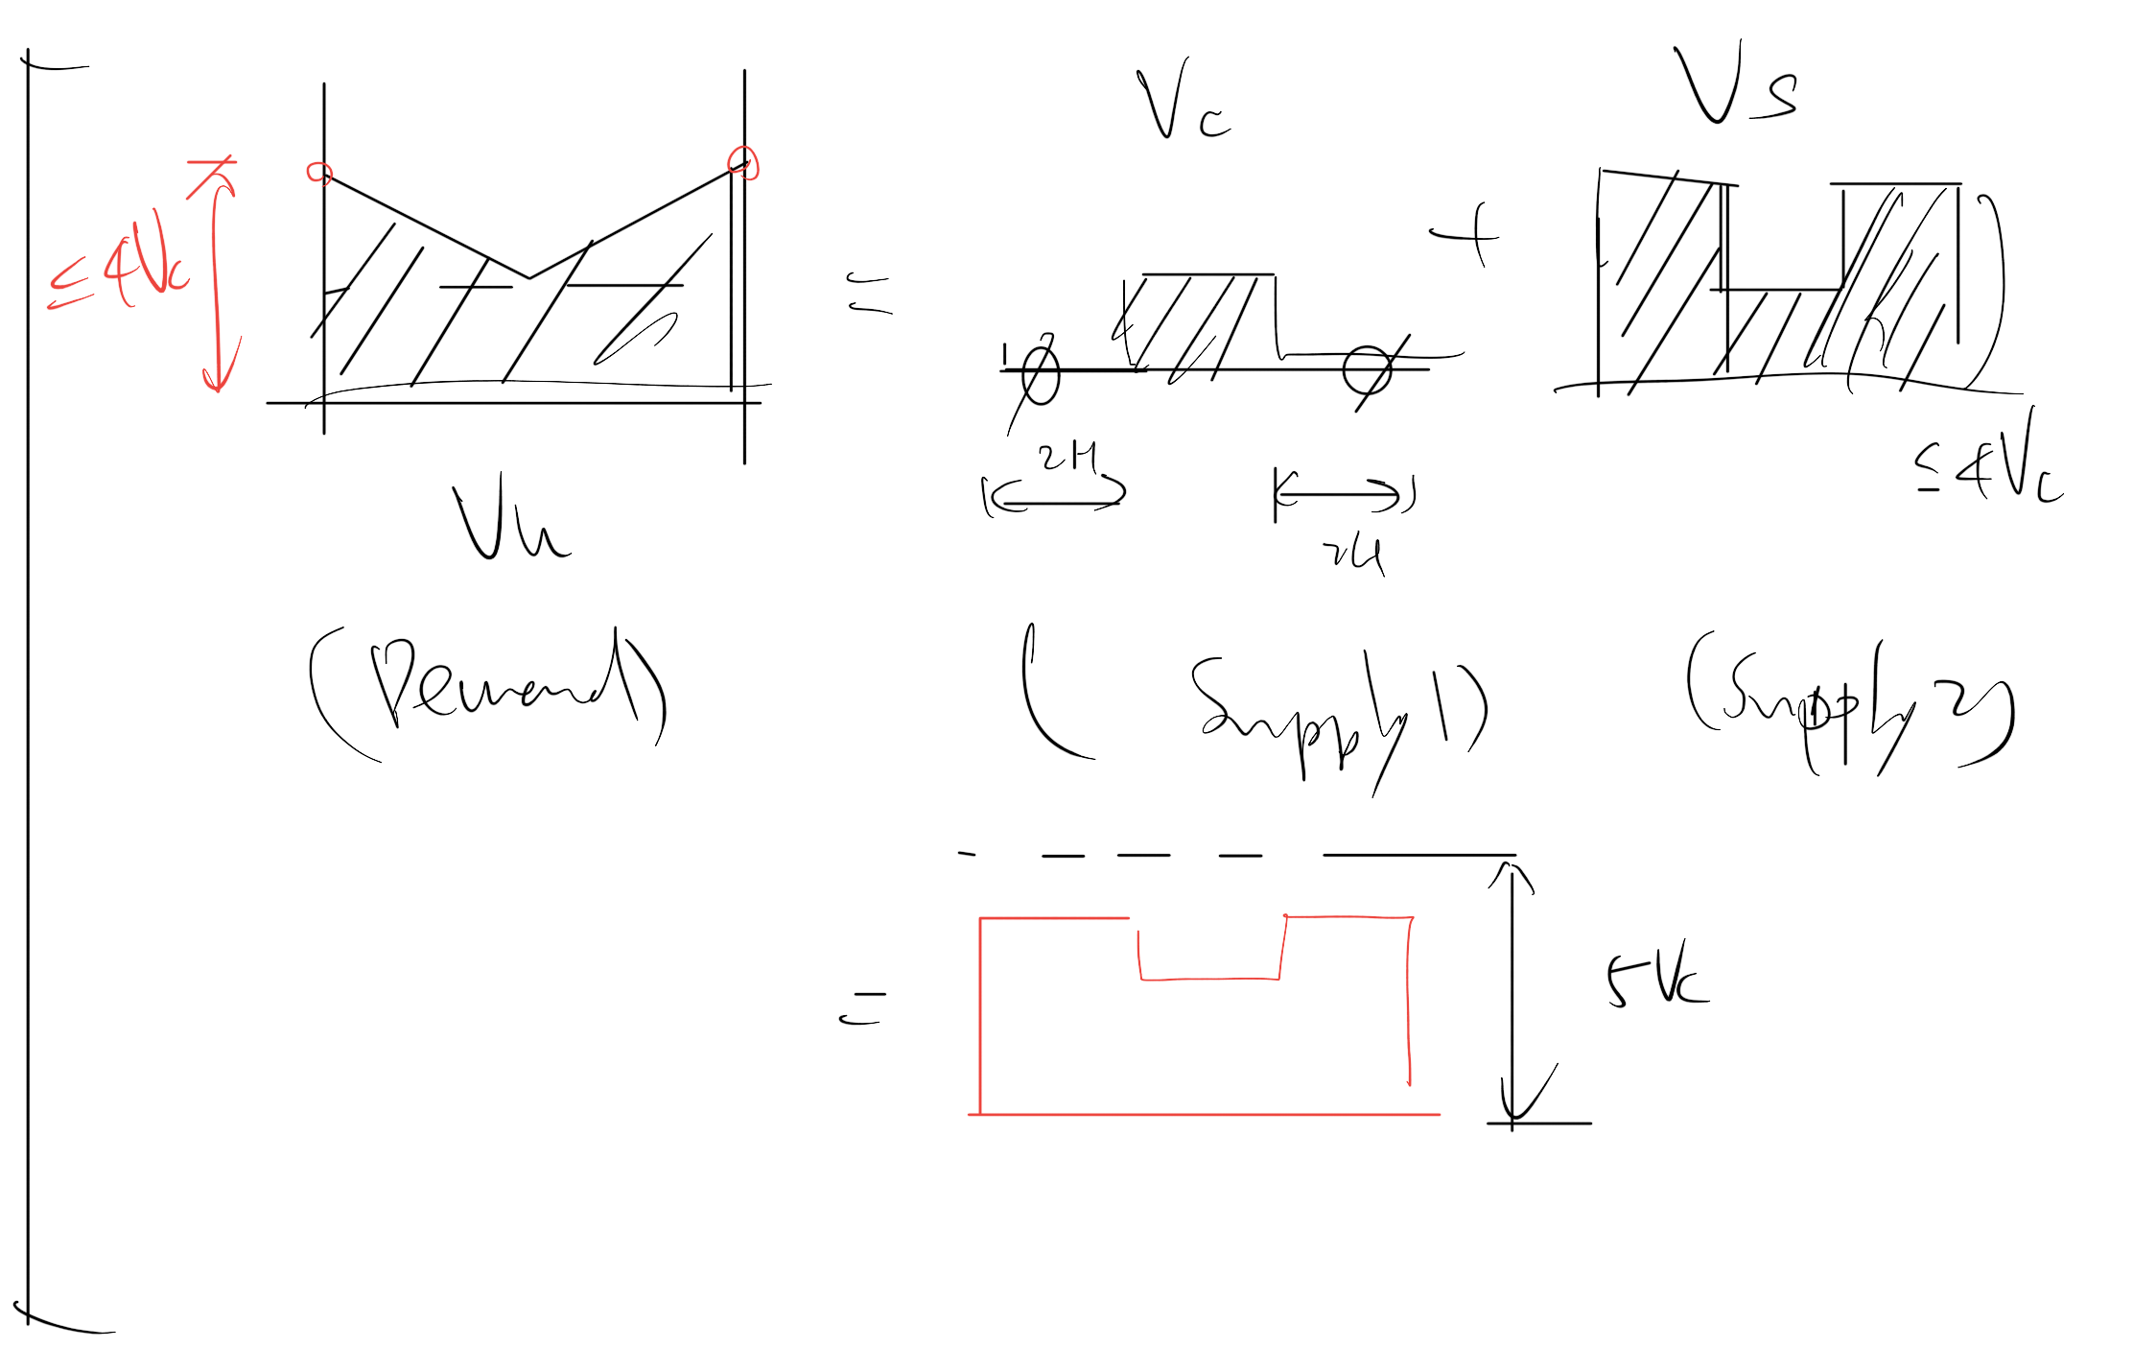

Slide 9
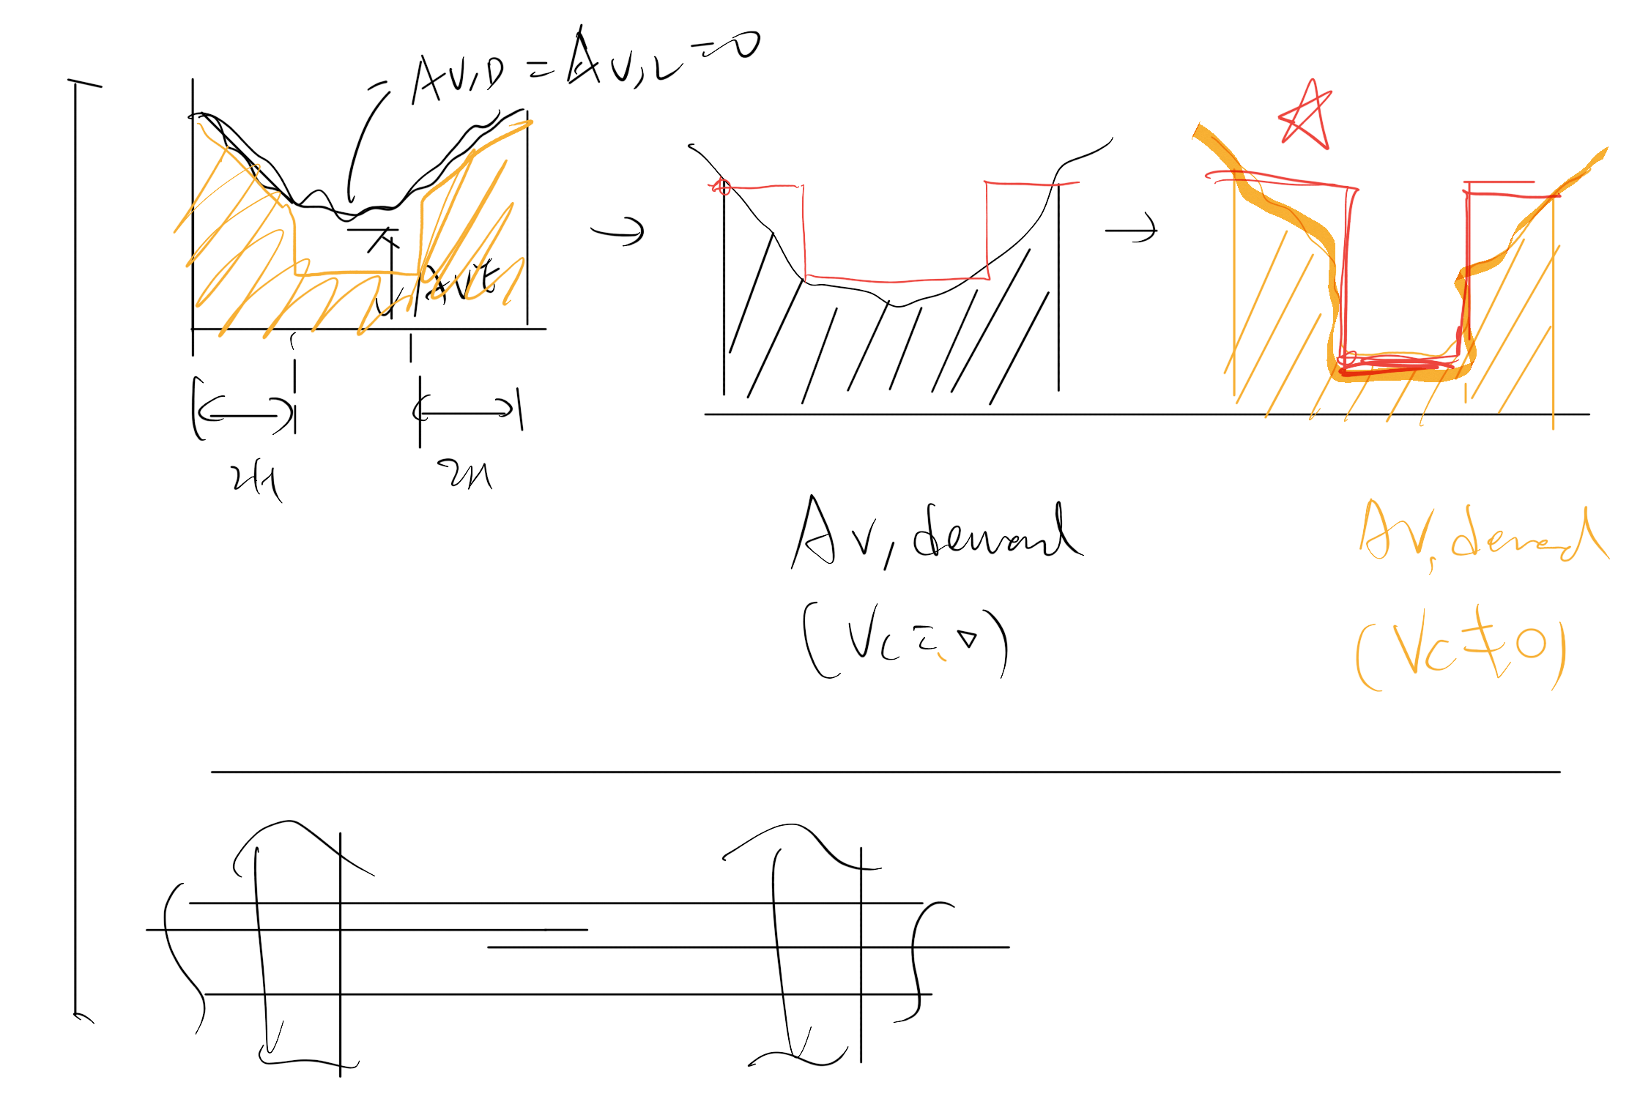

Slide 10
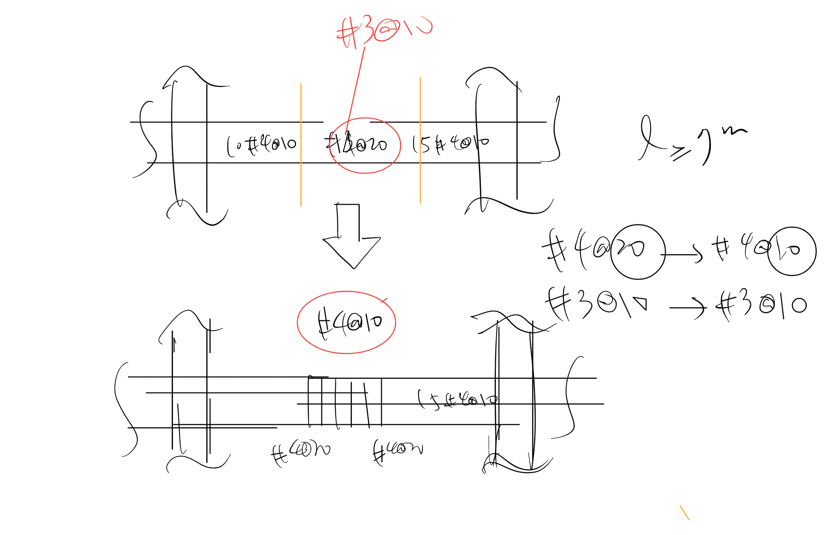

Slide 11
5 MULTI CUT
Pattern
…

Slide 12
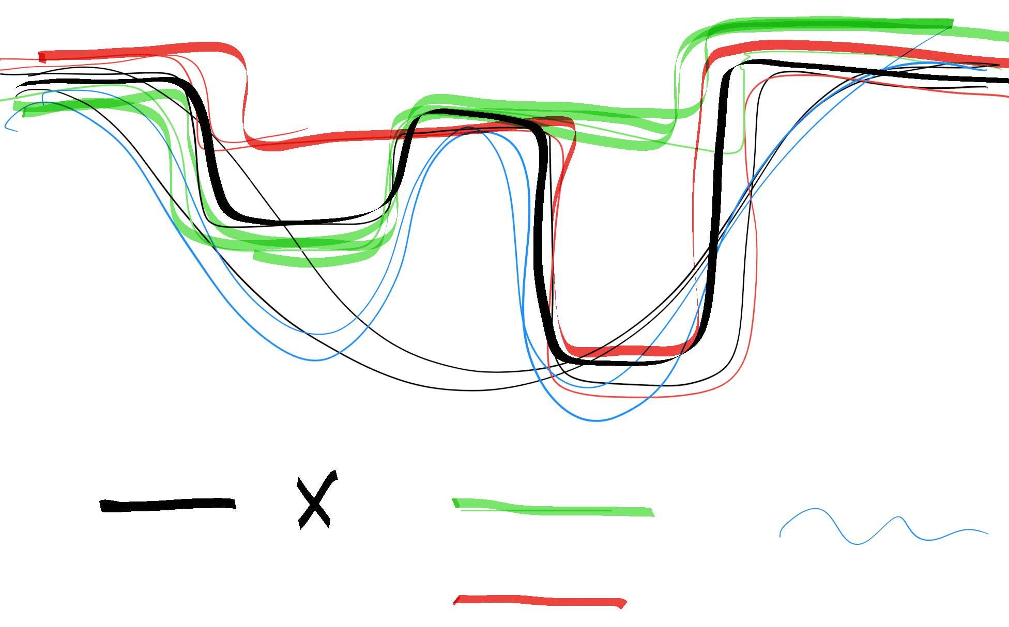
Five
Four
Demand

Slide 13
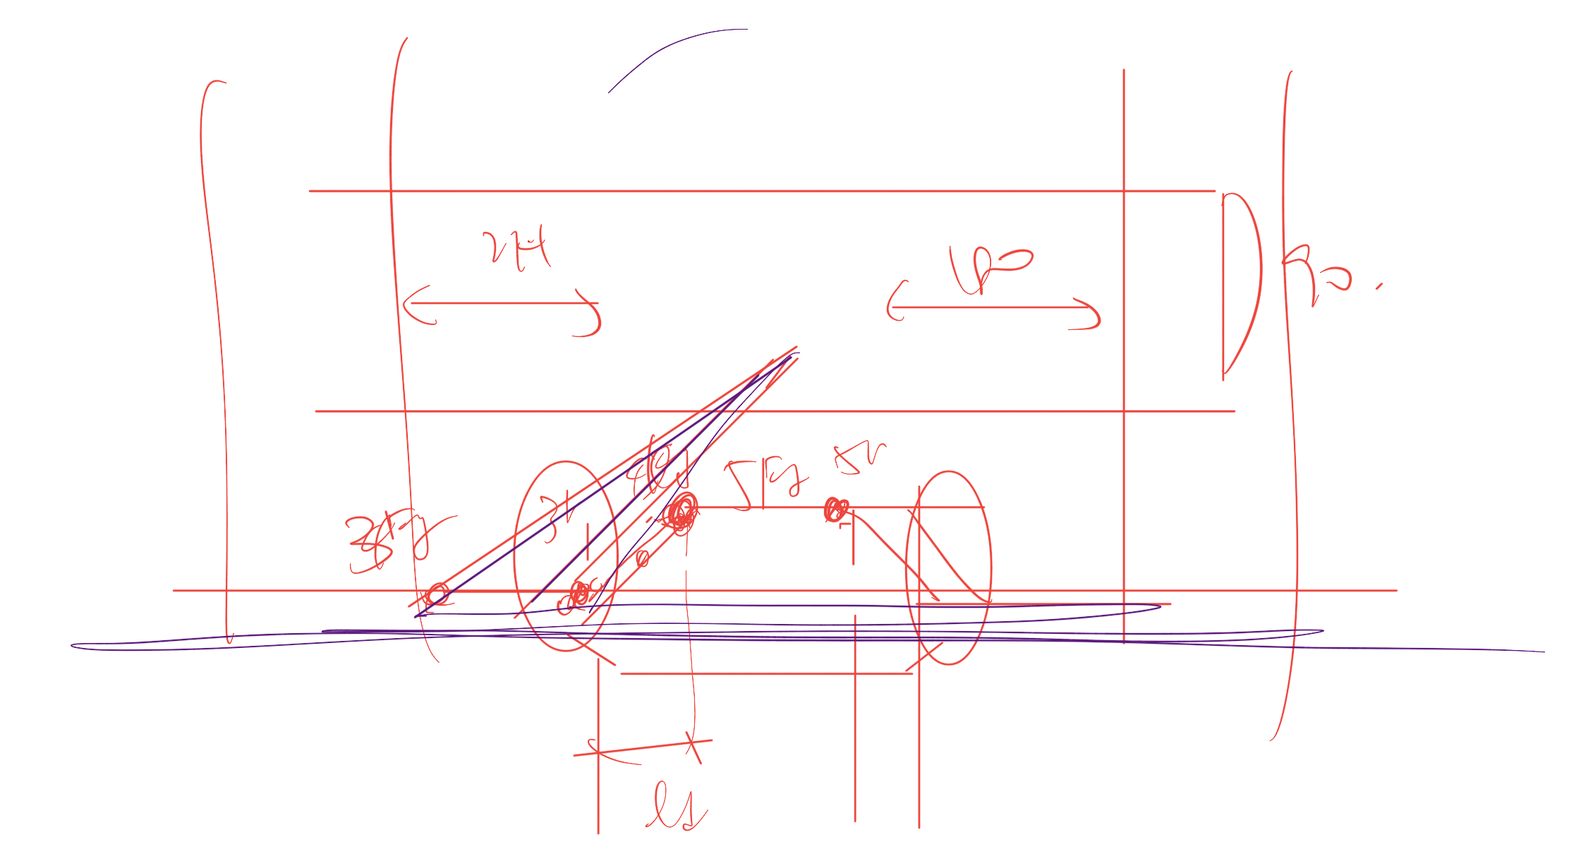
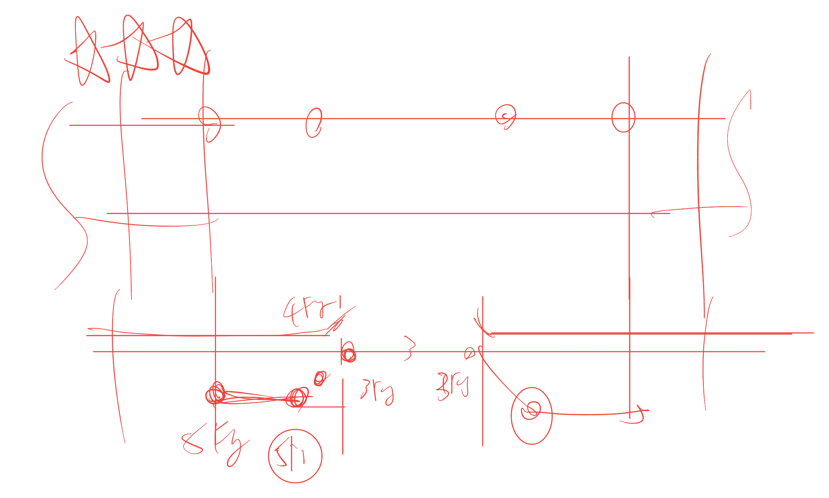
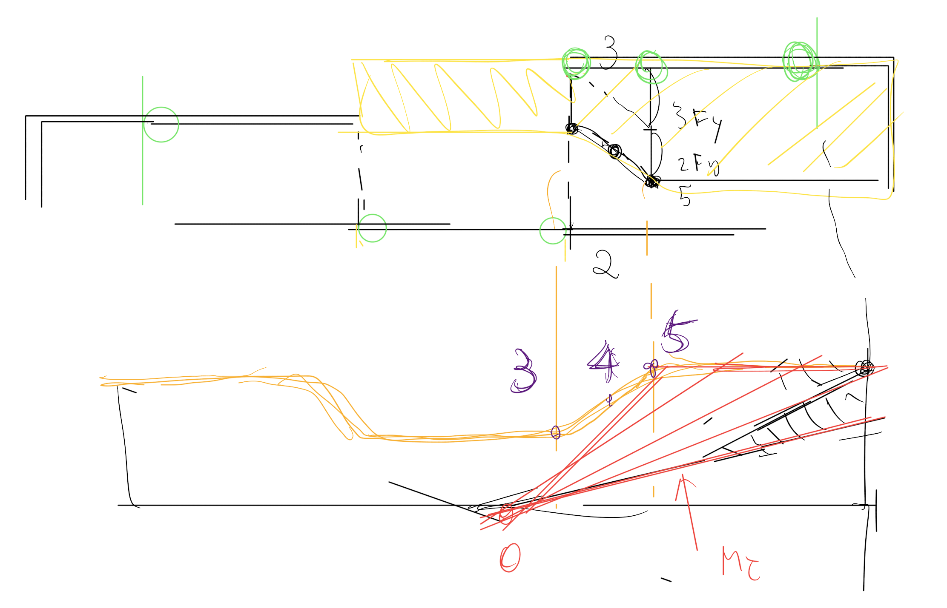
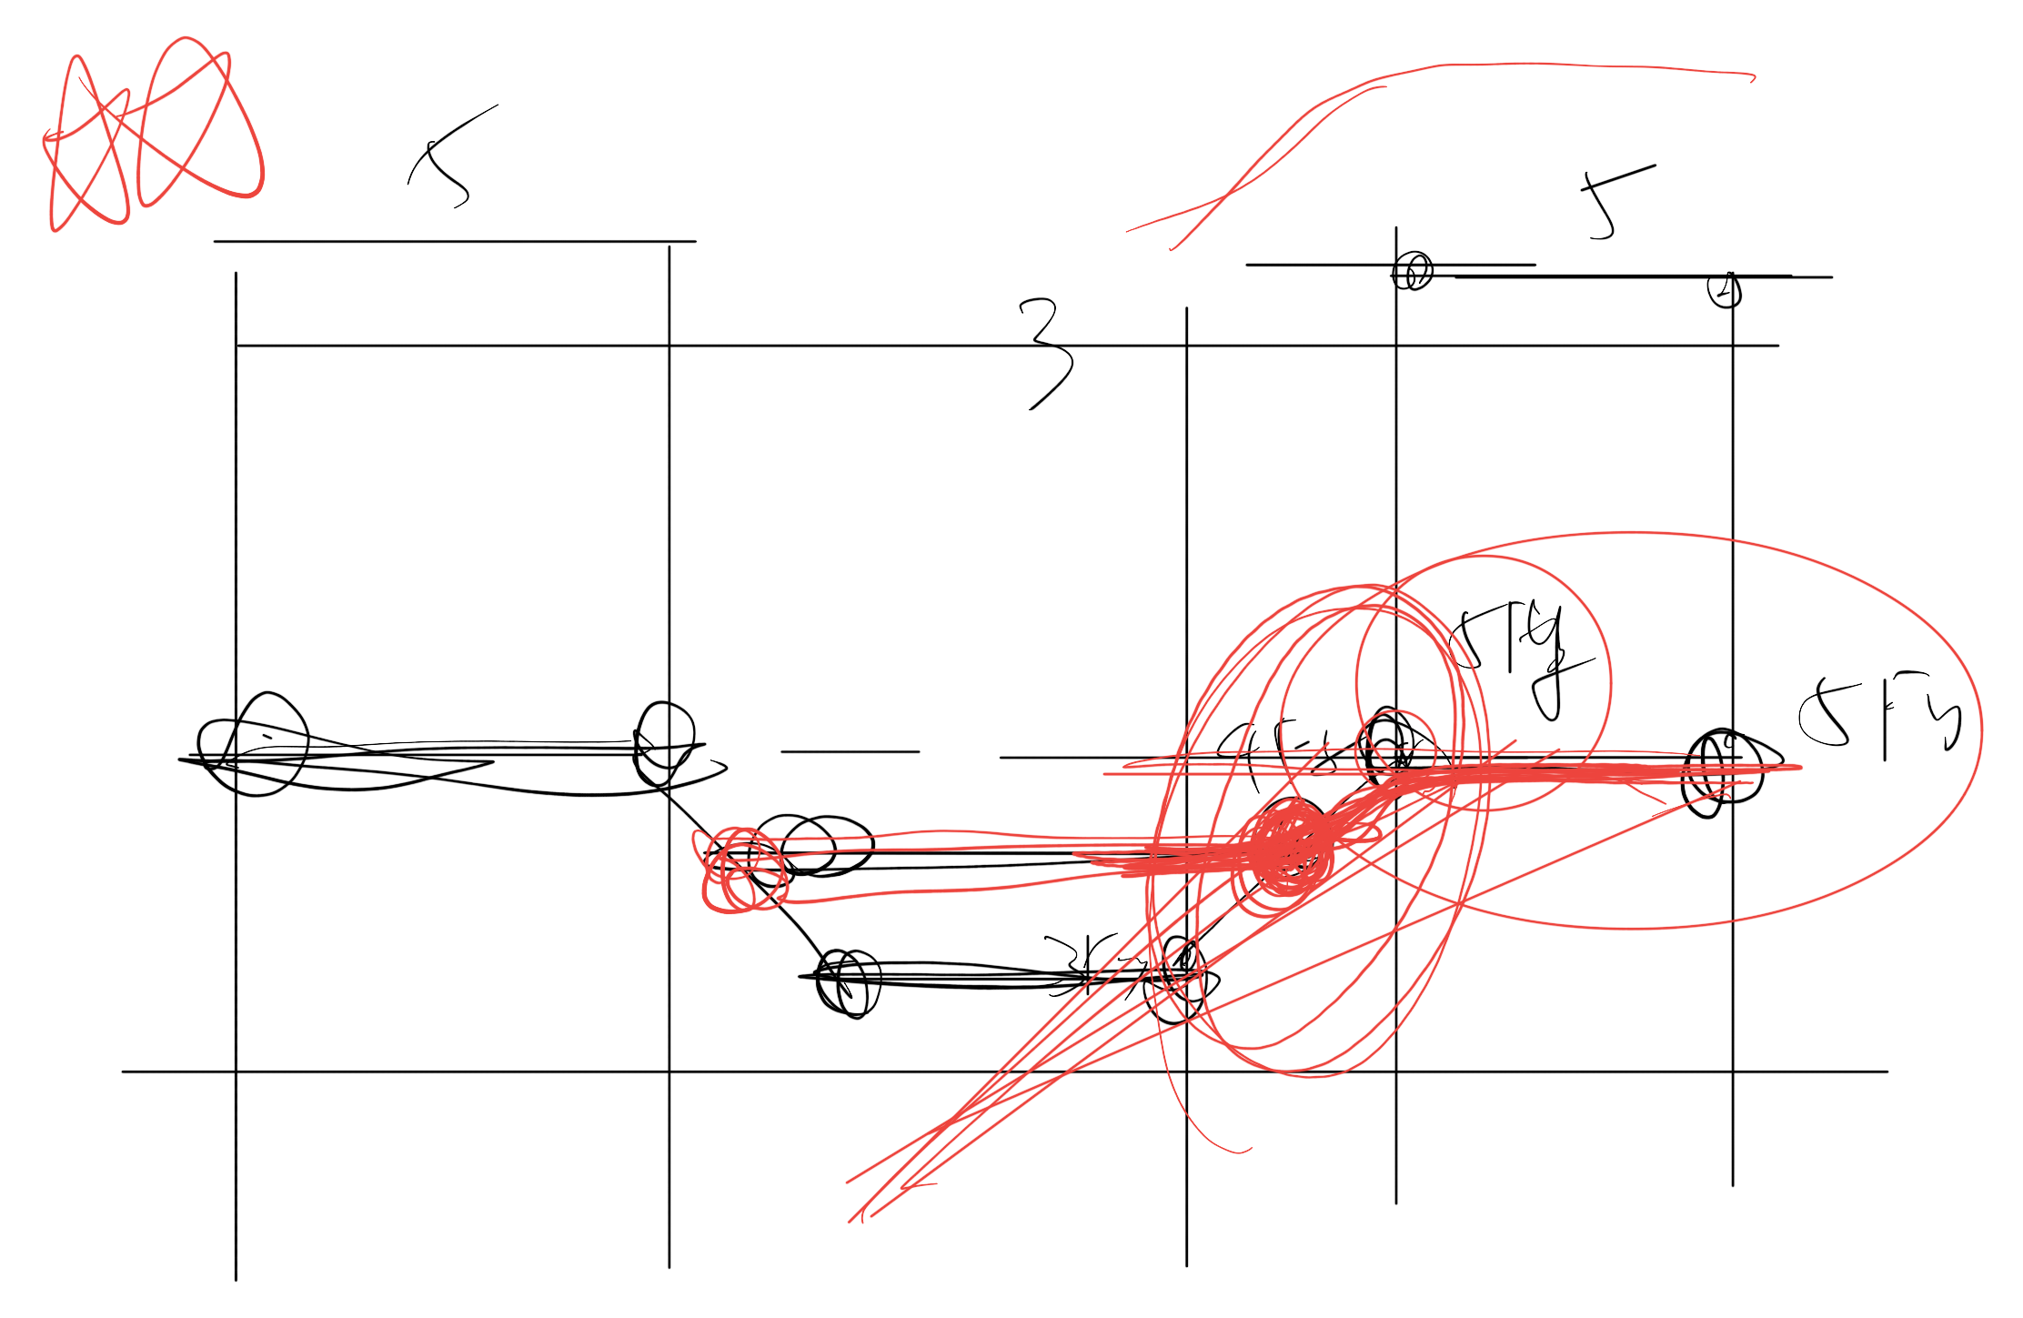

Slide 14
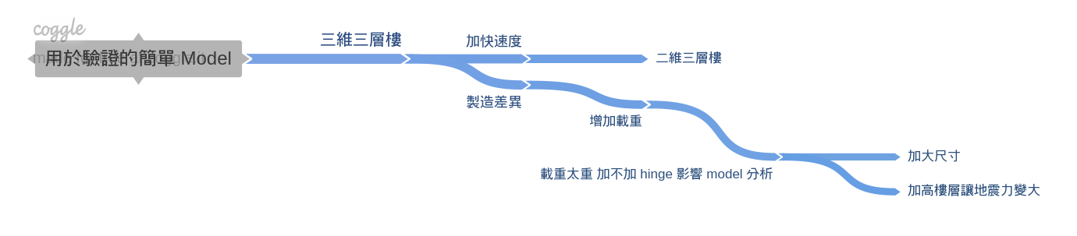
Nonlinear
Simple Model

Slide 15
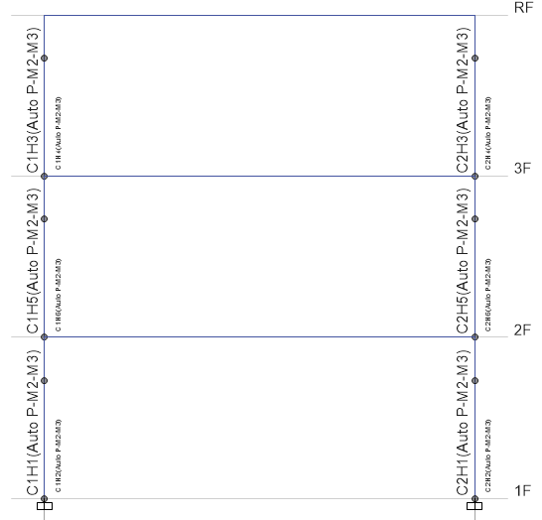
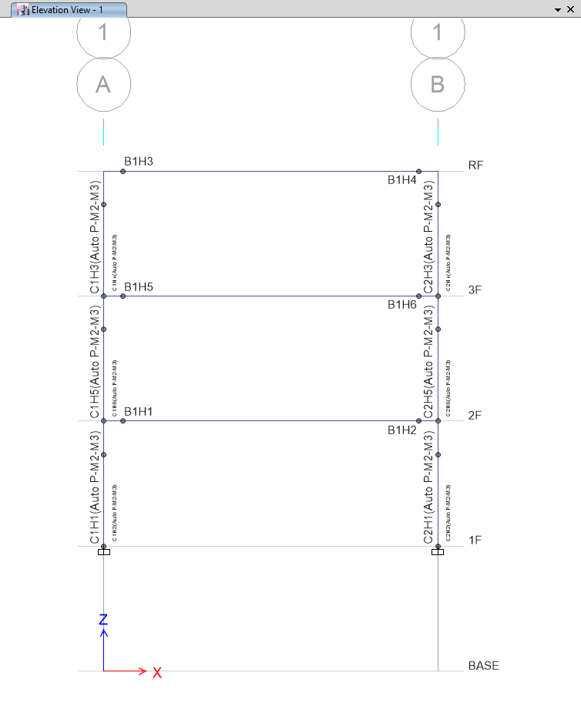
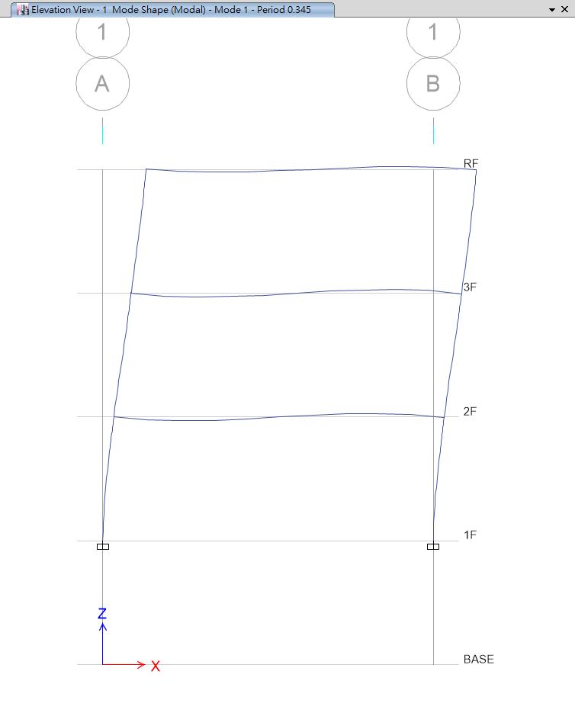
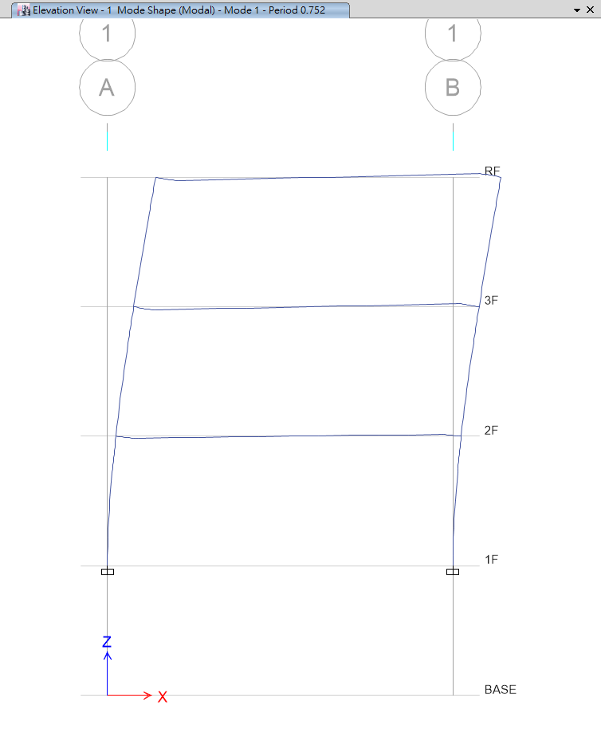
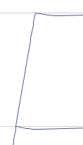
T=0.345
T=0.752
No Nonlinear Beam Hinge
Nonlinear Beam Hinge

Slide 16
Nonlinear
Simple Model

Slide 17
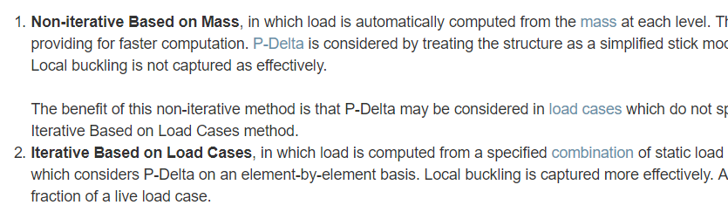
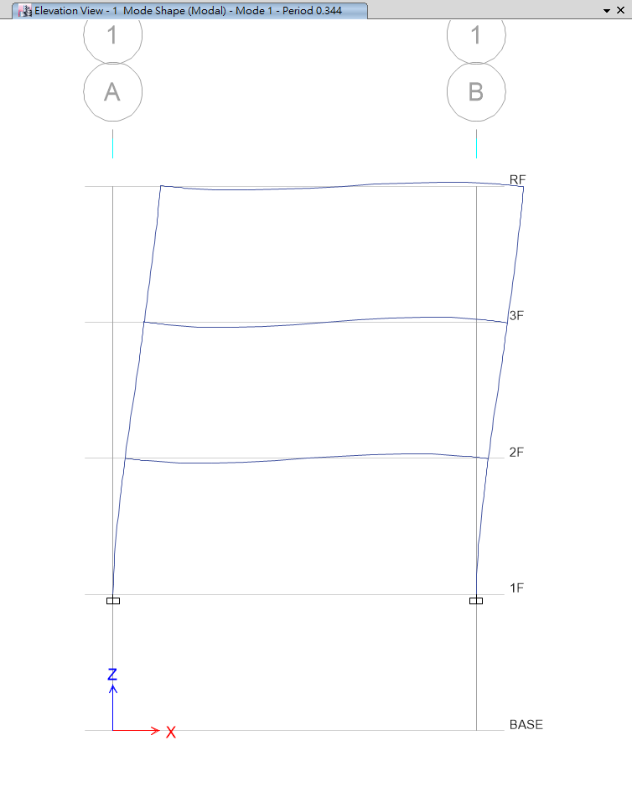
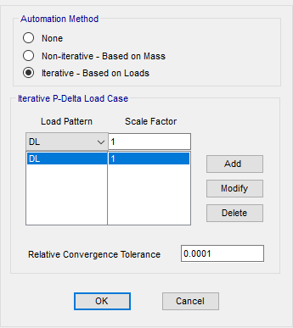
P-Delta
Local Buckling

Slide 18
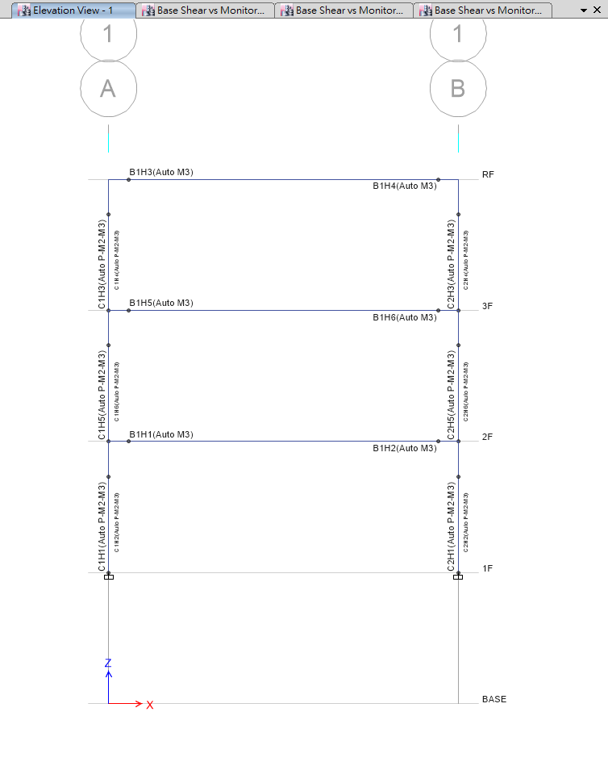
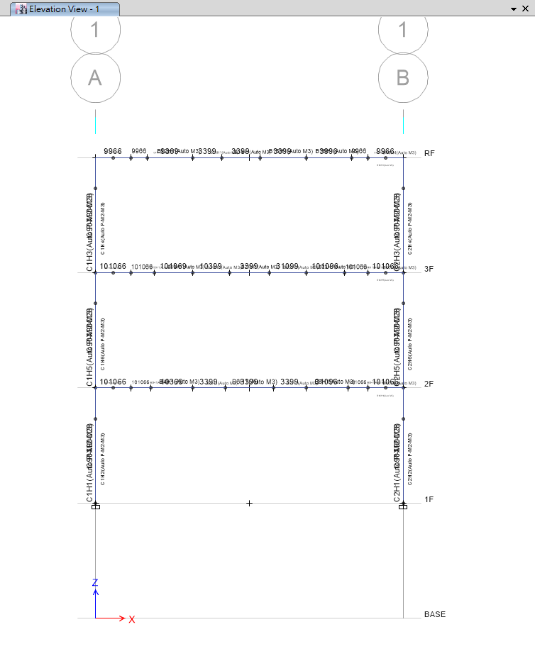
Normal Nonlinear Hinge
Multi Nonlinear Hinge

Slide 19
Multi Nonlinear Hinge
1
2
3
4
5
Multi Rebar
Calculate Ld
Divide Beam
Define Section
Assign Hinge

Slide 20
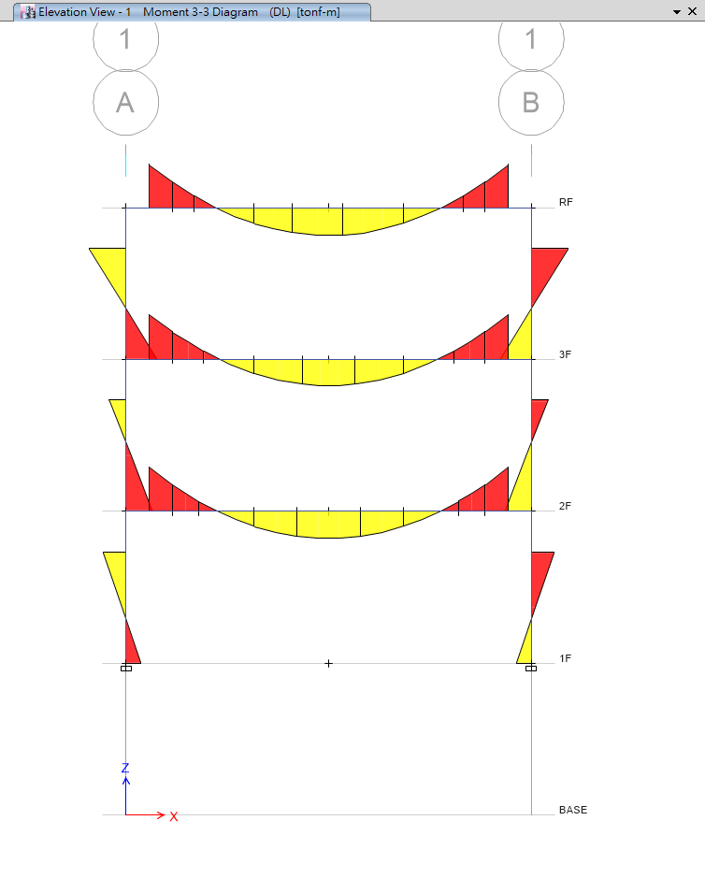
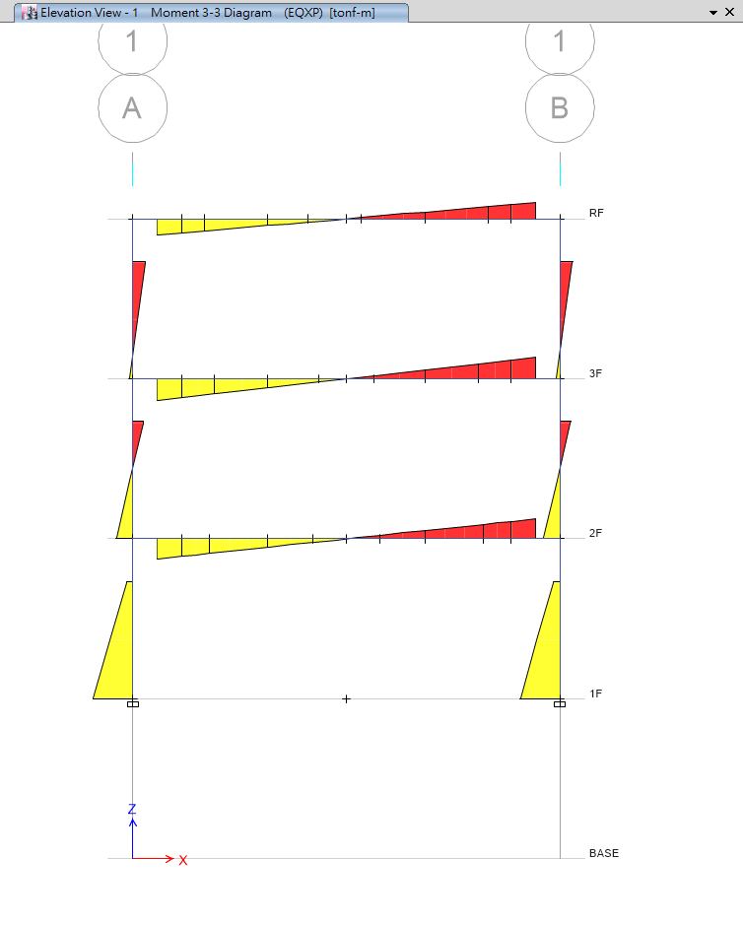

Slide 21
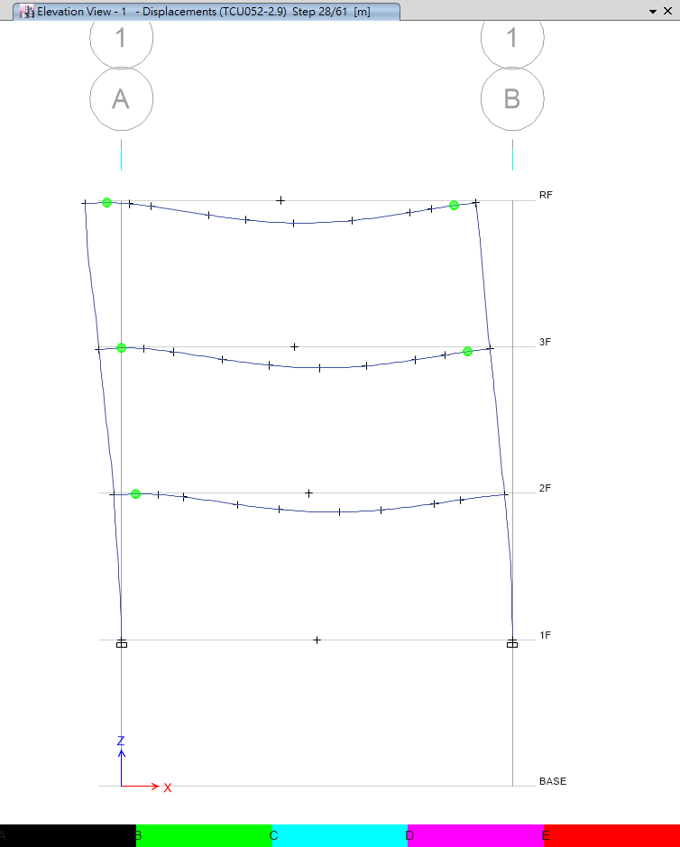
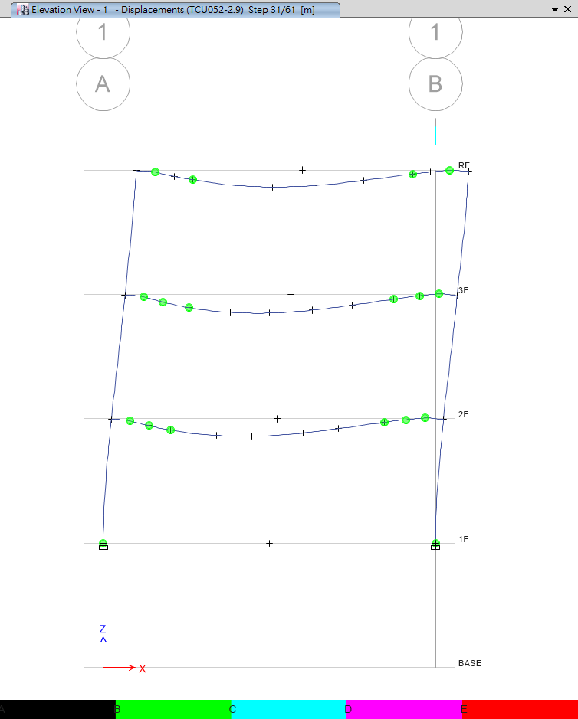
Step 28
Step 31

Slide 22
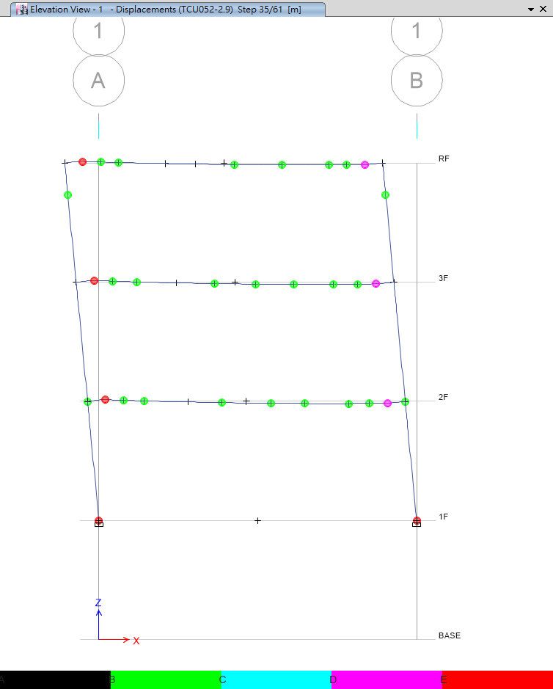
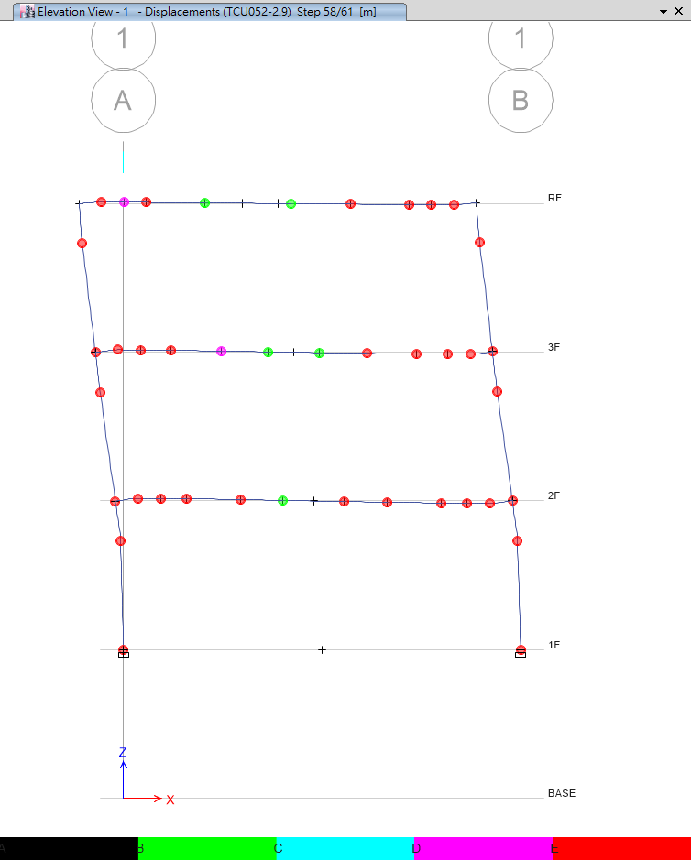
Step 35
Step 58

Slide 23
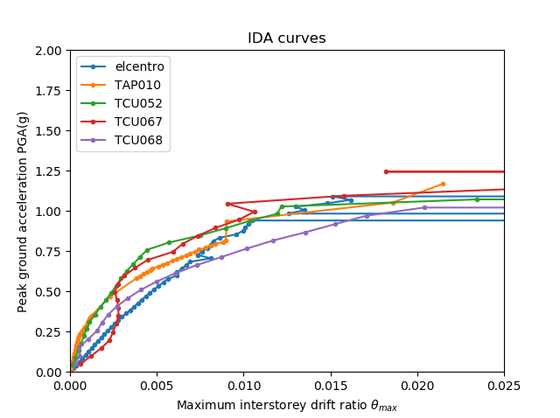
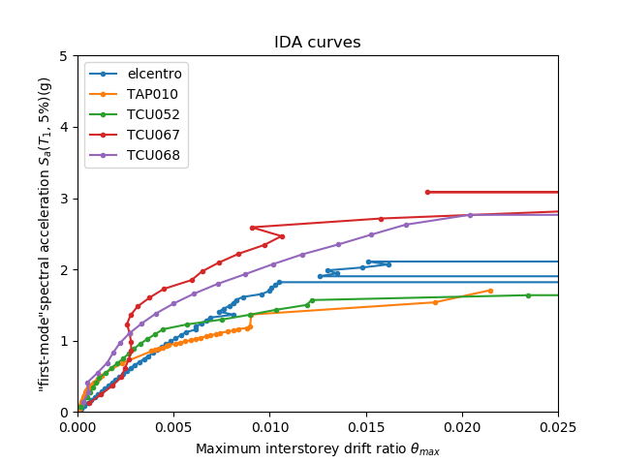
PGA vs First Mode

Slide 24
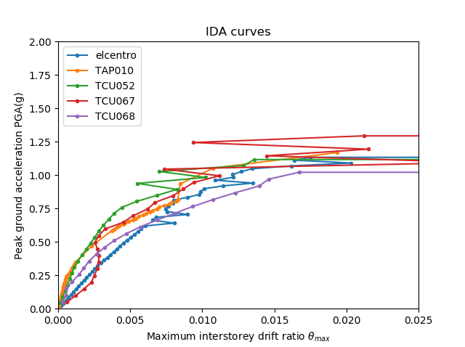
Normal vs Multi

Slide 25
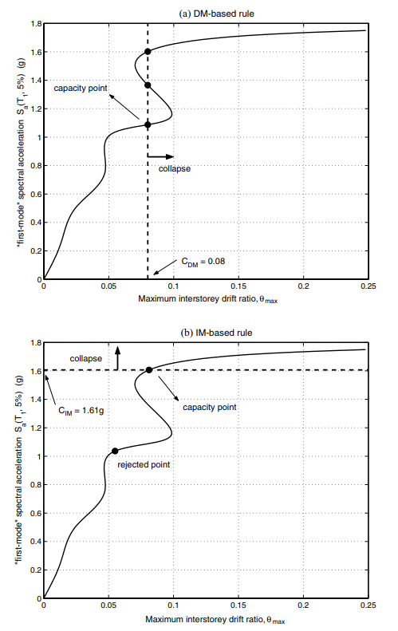
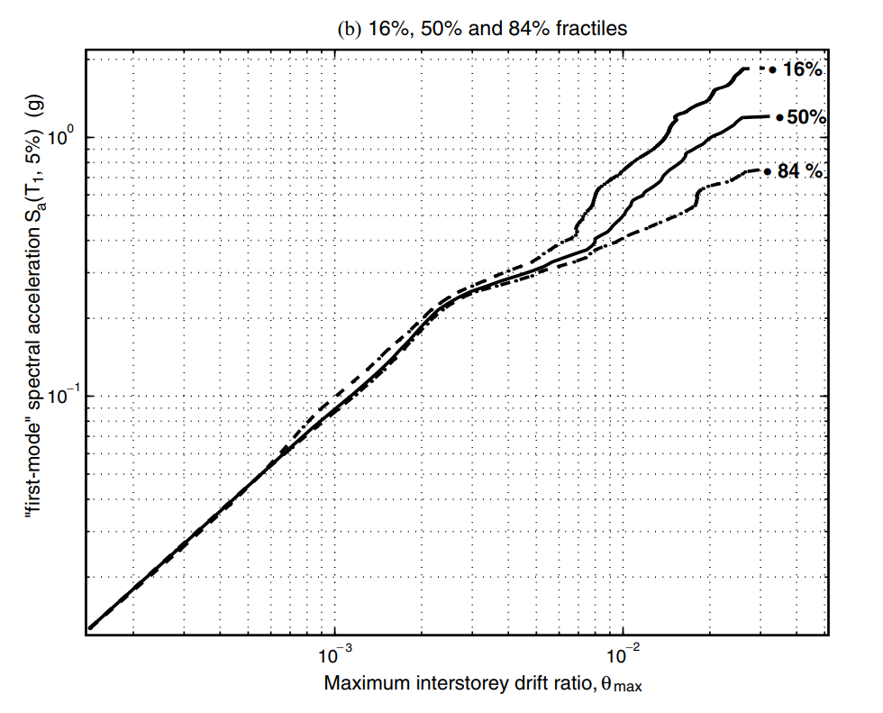
Next to Do

Slide 26
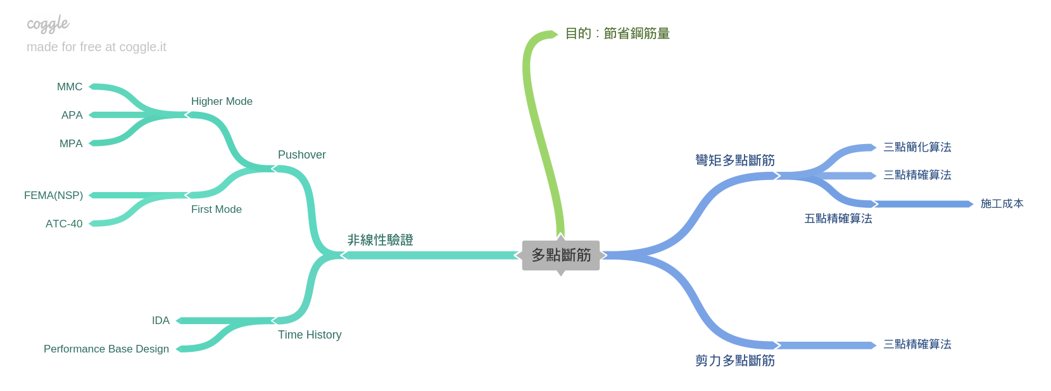
Roadmap

Slide 27
Roadmap
Next
人工斷筋
Now
03/2016
IDA
開發程式

